Slide 1
Data Analysis of Commodity Prices
BY Kapil Thakkar & Reshma Kumari
UNDER THE GUIDANCE OF Dr. Aaditeshwar Seth

Slide 2
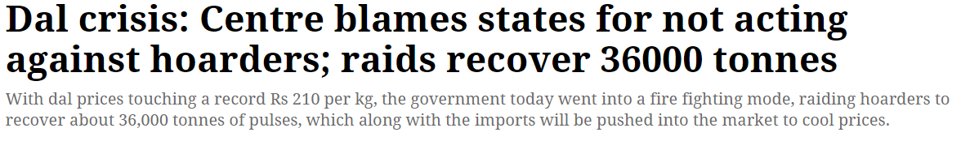
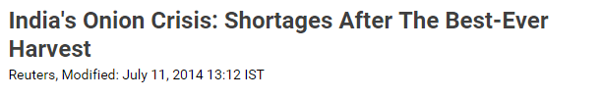
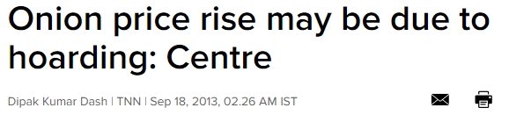
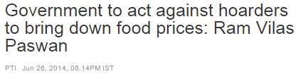
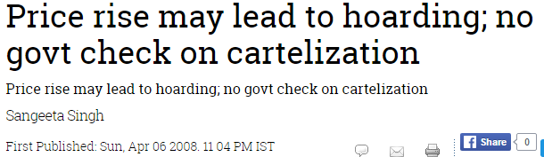
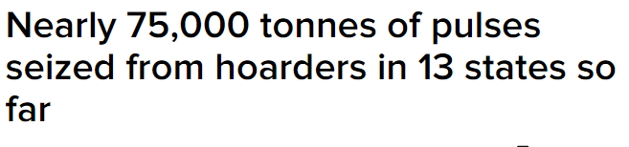

What News Reports!!

Slide 3
Motivation
Supply demand imbalance, natural calamities etc. may not always be the reason behind the rise in the price of a commodity.
It may be a consequence of artificial supply deficit planned intelligently by traders’ nexus for profiteering through manipulation of supply of commodity and hence indirectly controlling their prices.
Our attempt is to locate such hikes in prices which seem suspicious (we call them anomalies).
To detect and analyse the characteristics of anomalies in the prices of commodities, currently only onion

Slide 4
Objective
To develop an automated system which signal suspicious activities in given time series
Create library with set of methodologies to detect anomalies in the give input time series when provided with the behavior of time series
Anomalies will be based on the hypothesis stated by the user
For particular scenario stated by user, execute appropriate algorithms and report the anomalies in the time series

Slide 5
Hypothesis for Onion Time Series(1)
H1: In the absence of market abuse phenomena, there is a negative correlation between arrival and wholesale prices. i.e. If there is increase in arrival pattern, there should be decrease in the wholesale price and if there is decrease in arrival pattern, there should be increase in the wholesale price considering a lag factor of 15 days.
Assumption: farmers do not hoard which we can support as per our literature review
Test Criterion:
Cross correlation between arrival and wholesale price considering lag factor
Use of sliding window for calculating correlation with different window size
Slope based method
Linear Regression

Slide 6
Hypothesis for Onion Time Series(2)
H2: In the absence of market abuse phenomena, there is positive correlation between wholesale price and retail price. i.e. If there is increase in the wholesale price of onion, then there will be corresponding increase in the retail price and vice-versa
Assuming, demand remains constant and there is no supply shock created because of excessive export of onion
Test Criterion:
Cross correlation between wholesale and retail price considering lag factor
Use of sliding window for calculating correlation with different window size
Slope based method
Spike Detection in relative difference between retail and wholesale price
Linear regression

Slide 7
Hypothesis for Onion Time Series(3)
H3: The deviation between arrival - wholesale and wholesale- retail should not vary much compared to values for same time in past years.(Considering Seasonality within data)
This states that even if it is following H1 and H2, the variation should not be very large as compared to past years
Test Criterion:
Compare the difference generated by prediction based model like ARIMA and real value
Graph based Anomaly Detection Technique

Slide 8
Hypothesis for Onion Time Series(4)
H4: Mandis in the same region should follow the same relationship between arrival and wholesale price, as that of, taken whole region combinely.
Here, we assume that mandis in the same region will behave in similar manner, because production and effect of other factors will be same in one region
Test Criterion:
First generate combined time series from all Mandis
One method is using sum of arrivals and average of prices
Other method is subspace based transformation
Then compare each Mandi's time series with combined one, using methods stated in H1 and H2

Slide 9
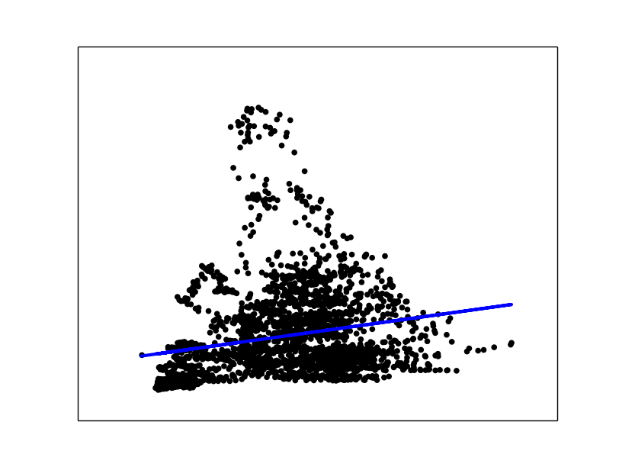
Some results: Linear Regression
Residual sum of squares: 158.98
Too Much...
Wholesale Price
Arrival

Slide 10
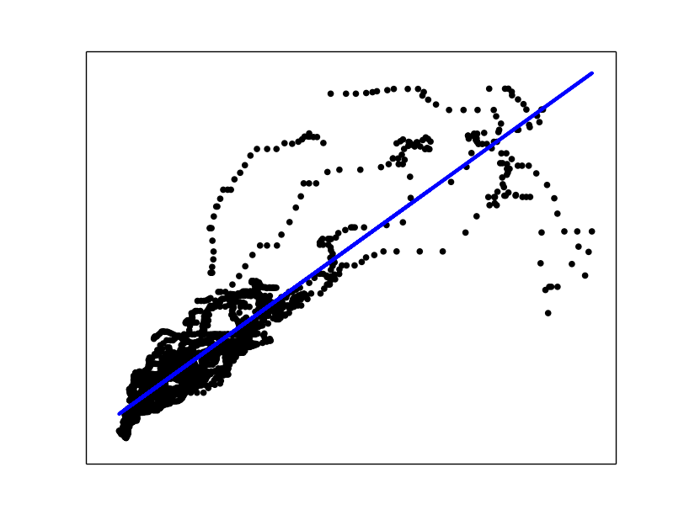
Some results: Linear Regression
Residual sum of squares: 82.97
Tolerable
Retail Price
Wholesale Price

Slide 11
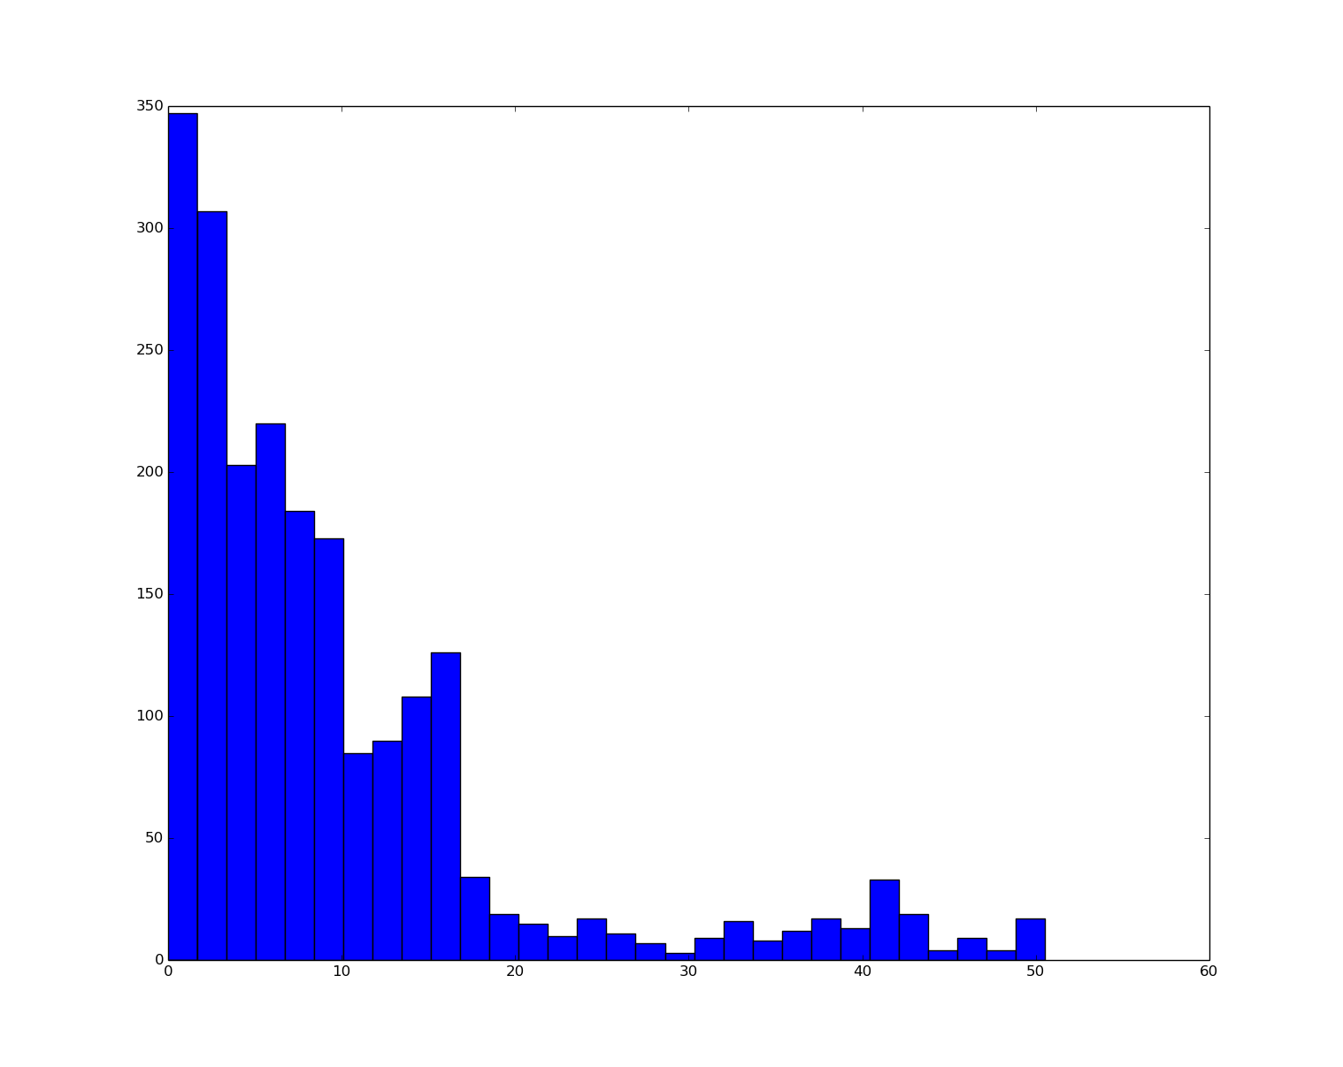
Some results: Linear Regression
Distribution of Prediction Error for Wholesale Price Vs Retail Price
Threshold can be determined using MAD test to detect outliers

Slide 12
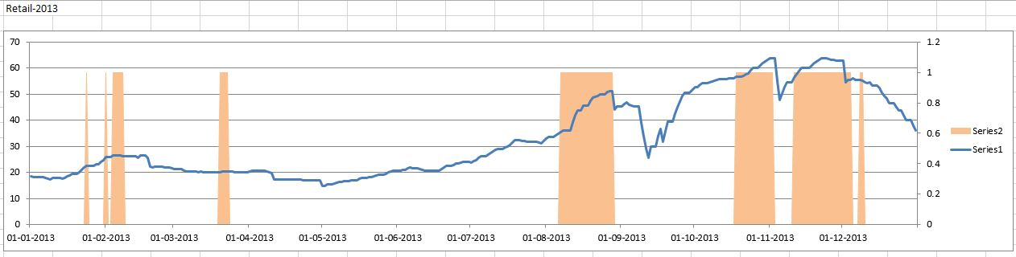
Some Results: Graph Based Anomaly Detection
Performed in R

Slide 13
System Design
Input Time-series
Relation Between Time-series (Hypothesis)
Automatic Selection of Functions and Processing Time series
Highlight Anomalies

Slide 14
System Design
Number of time series
Option to input each time series
Option to smooth time series
Input Time-series
Relation Between Time-series (Hypothesis)
Automatic Selection of Functions and Processing Time series
Highlight Anomalies

Slide 15
System Design
Matrix with n*n options with some default values
Option to state positive lag/ negative lag/ both/ maximum lag values
If user doesn’t not know relation and want to find one
Input Time-series
Relation Between Time-series (Hypothesis)
Automatic Selection of Functions and Processing Time series
Highlight Anomalies

Slide 16
System Design
Execute appropriate algorithms for given input
Input Time-series
Relation Between Time-series (Hypothesis)
Automatic Selection of Functions and Processing Time series
Highlight Anomalies

Slide 17
System Design
Display test conducted and their results, detailed values
Different graphs/chart if possible on user demand
Option to run tests again with some different threshold values
Input Time-series
Relation Between Time-series (Hypothesis)
Automatic Selection of Functions and Processing Time series
Highlight Anomalies

Slide 18
Thank You!
Any Questions?

